Slide 1

Future of Media Today
my best guess…
Steven King
UNC jSchool
@steven_king

Slide 2

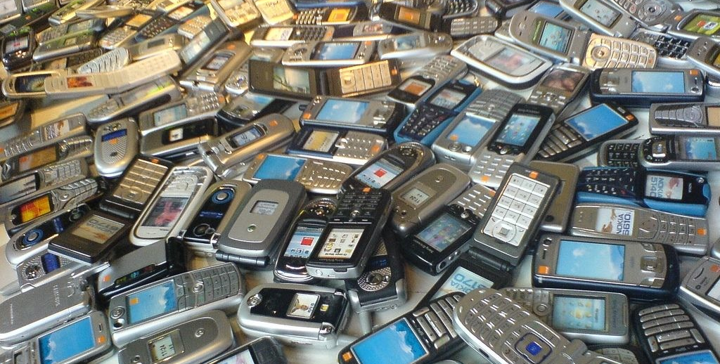
Start with the recent past…

Slide 3
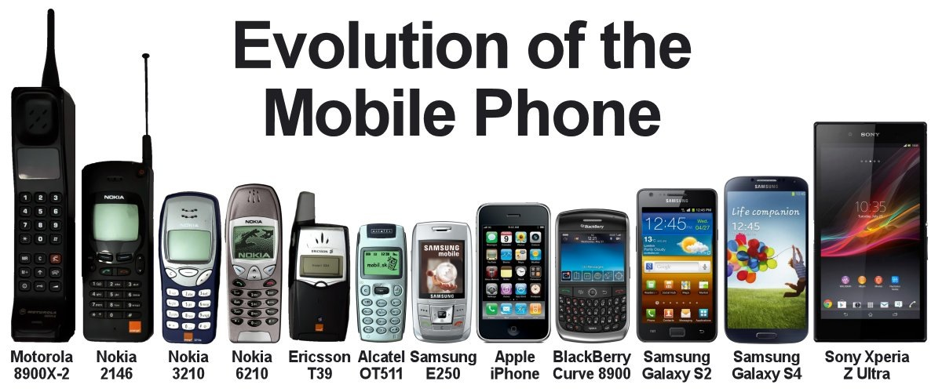
Evolving Technology
We have come a long way…

Slide 4
Evolving Technology
Limited Mobile Browser
Mobile Web (Flip and Bar Phones
Real Mobile Browser (Opera and later iPhone)
Android + others
Native Apps and Apps and Apps
Responsive Design
PhoneGap

Slide 5
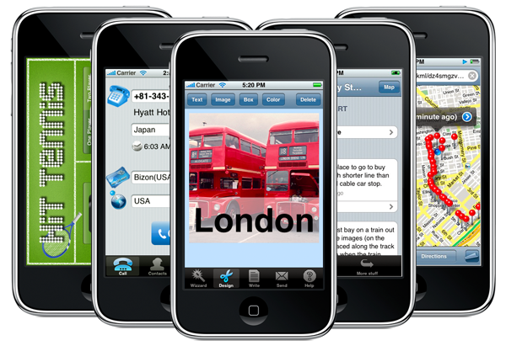
First Apps
They were mostly utility or news/information presentation apps
ex. Calculators, CNN News, Maps
Looked the same

Slide 6
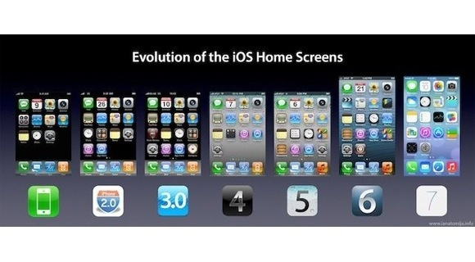

Slide 7
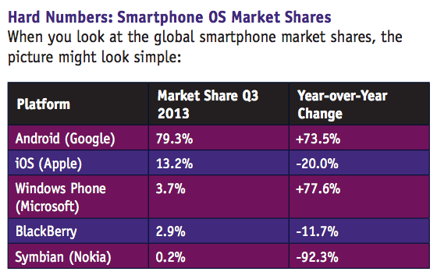
Market Share by platform
Android vs. iOS and the rest of the field

Slide 8
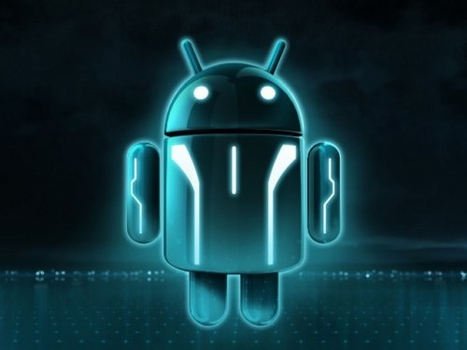
But what is next…
What comes after the phone…

Slide 9

Screens Everywhere
A Day Made of Glass | Corning R&D

Slide 10

Connected Devices
Personal, mobile network of connected devices

Slide 11

Location Based Apps
iBeacons

Slide 12
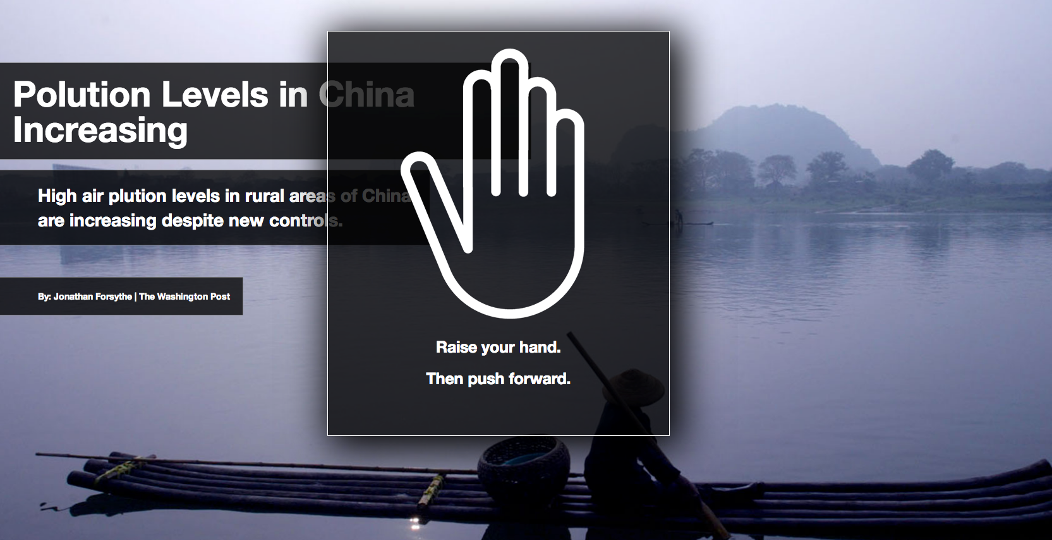
Non-Touch Gestures
Kinect and Leap Motion

Slide 13
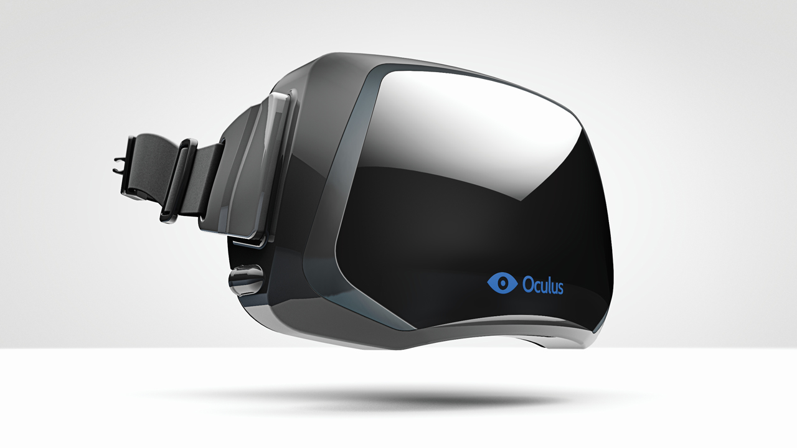
Consumer Level VR
Virtual Reality with Oculus Rift and Smart Phones

Slide 14
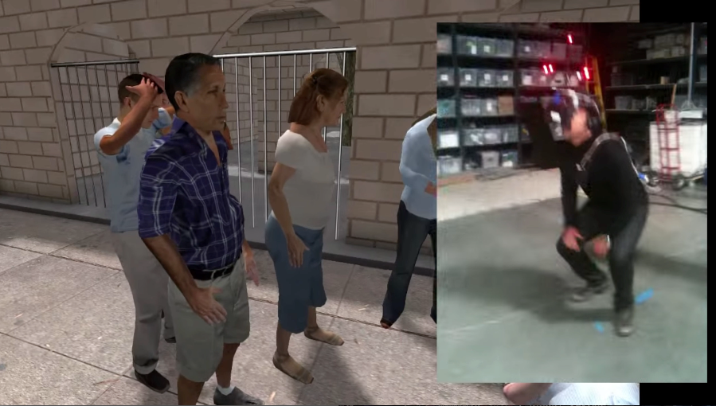
Rift + Gestures
http://oculusrift-blog.com/immersive-journalism/2243/
Combining technologies for full experience

